Slide 1


Slide 2

#LifeKoKaroLift
SGC Coaching:
Articulate your Journey | Activate Your Vigour| Accelerate Mutual Growth
Session 12
Tree Models

Slide 3
Agenda
Introduction (15 min)
Focused Teaching (60 min)
Doubts Resolutions (15 min)
coach introduction.
Decision Tree
doubts resolutions
learner introduction
Random forest

Slide 4
Introduction – Coach
About Myself
Education
Experience
Motivation
Why mentoring
Notes:
Start with theme of how to show accountability and take initiatives and accepting your mistakes to take corrective actions

Slide 5
Introduction - Learner
About Yourself
Why Upgrad
Why Deep learning
Career Goal
Coding level (1-5)
Notes:
Start with theme of how to show accountability and take initiatives and accepting your mistakes to take corrective actions

Slide 6
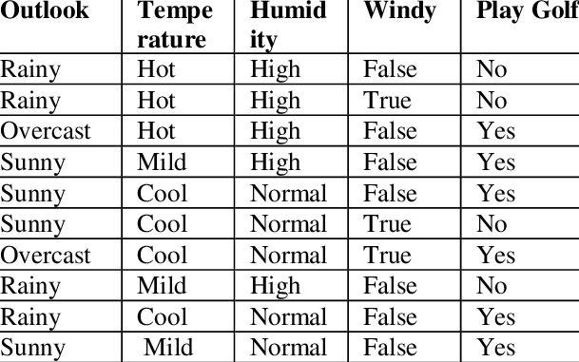
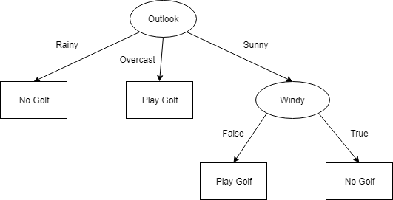
Focused Learning – Decision Tree -intro
Notes:
Start with theme of how to show accountability and take initiatives and accepting your mistakes to take corrective actions

Slide 7
Focused Learning – Decision Tree -type
CART
ID3
C4.5
C5.0
CHAID
Notes:
Start with theme of how to show accountability and take initiatives and accepting your mistakes to take corrective actions

Slide 8
Focused Learning – Decision Tree –pros and cons
Advantage
Less effort for data preparation
Not require normalization
Not require scaling
No missing values affect
Easy to explain
Disadvantage
Small change huge damage
Calculation can go far more complex
higher time to train
Expensive as the complexity and time.
continuous values
Notes:
Start with theme of how to show accountability and take initiatives and accepting your mistakes to take corrective actions

Slide 9
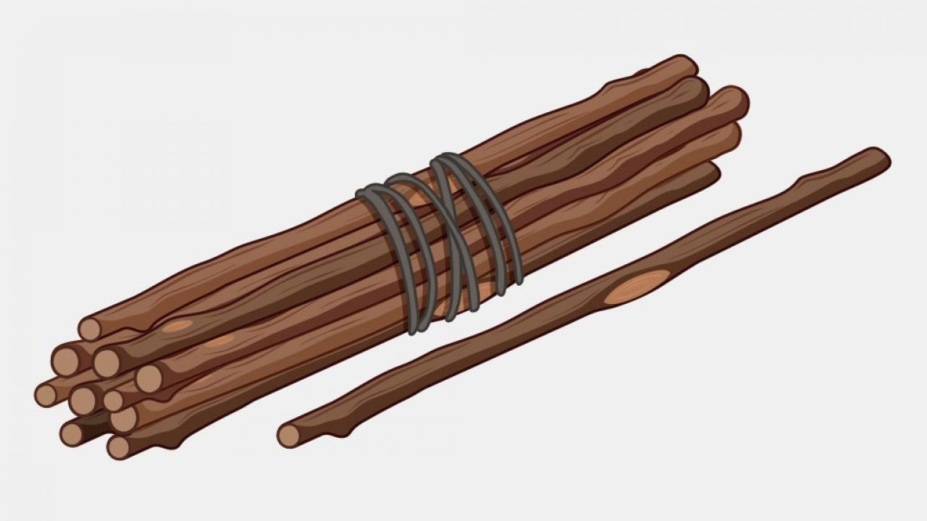
Focused Learning – Unity

Slide 10
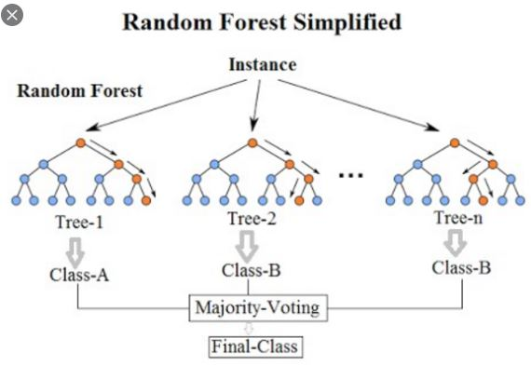
Focused Learning – Random Forest
Notes:
Start with theme of how to show accountability and take initiatives and accepting your mistakes to take corrective actions

Slide 11
Focused Learning – Decision Tree
Coding Time
Notes:
Start with theme of how to show accountability and take initiatives and accepting your mistakes to take corrective actions

Slide 12

Doubts Resolutions

